Slide 1
OSI AND TCP/IP MODEL
BASIC NETWORKING

Slide 2
Objective
Explains how standards ensure greater compatibility and interoperability between various types of network technologies.
Learn how the OSI reference model networking scheme supports networking standards.
Learn about the basic functions that occur at each layer of the OSI model, which will serve as a foundation as you begin to design, build and troubleshoot networks.

Slide 3

MODEL OF COMMUNICATION

Slide 4
Networking History
Standalone Device.
  Duplication of equipments and resources.
  Inability to communicate efficiently.
  Lack of networking management.
LAN.
  Connects devices that are close together.
WAN.
  Interconnects LANs across a large area.

Slide 5
Analyzing network in layers
What is flowing ?
Data
What different forms flow ?
Text, Graphic, Video ...
What rules govern flow ?
Standard, Protocol ...
Where does the flow occur ?
Cable, Atmosphere ...

Slide 6
Communication
Transmission of information.
Examples:
  Speaking.
  Smoke signal.
  Body language.
  Morse.
  Telephone.
  Broadcast systems (radio, television).
  Internet

Slide 7



Communication process
Packets
Protocols
Source
Address
Medium
Destination
Address

Slide 8
Communication characteristics
Addresses
  Who are the source and the destination of a communication process?
Media
  Where is the communication take place?
Protocols
  How to make the communication process effectively?

Slide 9
Communication: Human conversation
Address
  Hello Mr.A, I am B
Media
  Atmosphere
Protocol
  Language
  Speed
  Handshaking

Slide 10
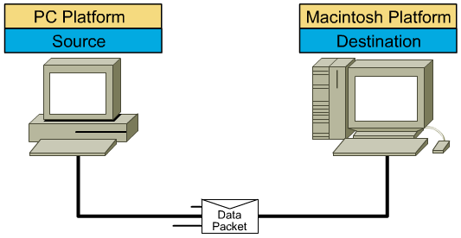
Data Communication
Address
  Source address, Destination address
Media
  Cable, Fiber, Atmosphere
Protocol
  Format
  Procedure

Slide 11
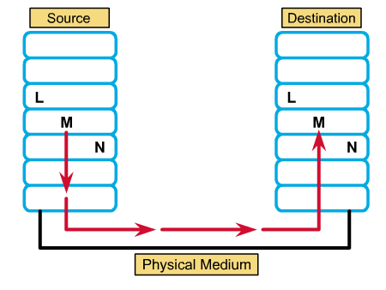
Protocol
Protocol is a set of rules, or an agreement, that determines the format and transmission of data that make communication on a network more efficient.

Slide 12
Protocol examples
In transportation
In communication
In social
Brainstorming

Slide 13

OSI MODEL

Slide 14

Evolution of networking standards
SNA
Standard
Interconnection
Development
Simplification
Proprietary
TCP/IP
DECNET

Slide 15
OSI model development
Researched and developed by the ISO - International Organization for Standardizations.
1977: establish a subcommittee to develop a communications architecture.
1984: publish ISO-7498, the Open System Interconnection (OSI) reference model.

Slide 16
OSI model
The OSI model: a framework within which networking standards can be developed.
  It provided vendors with a set of standards that ensured greater compatibility and interoperability between the various types of network technologies that were produced by the many companies around the world.
Proprietary vs. Open

Slide 17
A layered model
The communications functions are partitioned into a hierarchical set of layers.
Each layer performs a related subset of the functions required to communicate.
Each layer relies on the next lower layer to perform more primitive functions and provides services to the next higher layer.
→The OSI Model define a set of layers and the services performed by each layer

Slide 18
Why a layered model?
Reduces complexity.
Standardizes interfaces.
Facilitates modular engineering.
Ensures interoperable technology.
Accelerates evolution.
Simplifies teaching and learning.

Slide 19
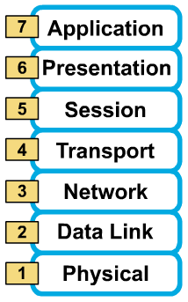
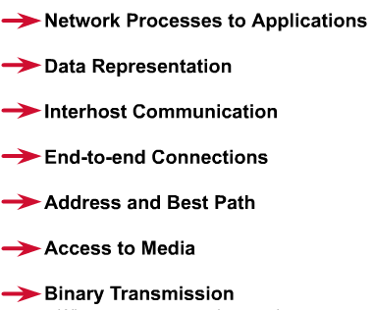
7 layers of the OSI reference model
Layer 7: Application
Layer 6: Presentation
Layer 5: Session
Layer 4: Transport
Layer 3: Network
Layer 2: Data Link
Layer 1: Physical
All People Seem To Need Data Processing

Slide 20
The physical layer
Transmission of an unstructured bit stream over a physical link between end systems.
  Electrical, mechanical, procedural and functional specifications
  Physical data rate
  Distances
  Physical connector

Slide 21
The data-link layer
Provides for the reliable transfer of data cross a physical link.
  Frames
  Physical address
  Network topology
  Line discipline
  Synchronization
  Error control
  Flow control

Slide 22
The network layer
Provides connectivity and path selection between two host systems that may be located on geographically separated networks.
  Packets
  Virtual circuits
  Route, routing table, routing protocol
  Logical address
  Fragmentation

Slide 23
The transport layer
Provides reliable, transparent transfer of data over networks.
  Segments, data stream, datagram
  Connection oriented and connectionless
  End-to-end flow control
  Error detection and recovery
  Segmentation & reassembly

Slide 24
The session layer
Establishes, manages, and terminates sessions between two communicating hosts.
  Sessions
  Dialog
  Conversations
  Data exchange

Slide 25
The presentation layer
Ensures that the information that the application layer of one system sends out is readable by the application layer of another system.
  Format of data
  Data structure
  Data conversion
  Data compression
  Data encryption

Slide 26
The application layer
Is the OSI layer that is closest to the user; it provides network services to the user’s applications.
  File transfer
  Electronic mail
  Terminal access
  Word processing
  Intended communication partners

Slide 27




Encapsulation example: Air-mail

Slide 28
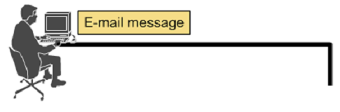




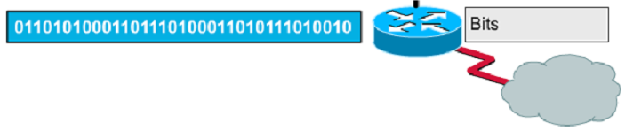
Encapsulation example: E-mail

Slide 29
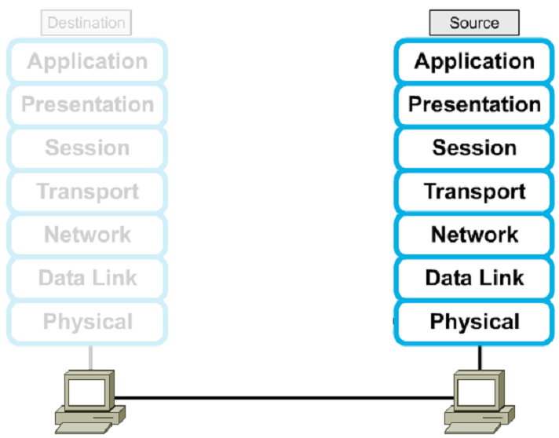




Encapsulation

Slide 30


Layer-to-layer communications
Provide services
Request services

Slide 31
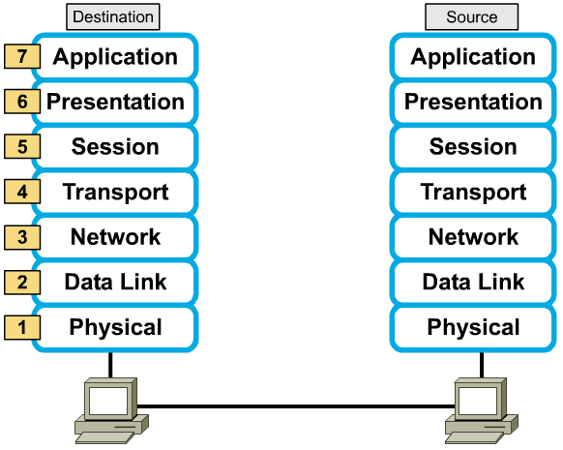
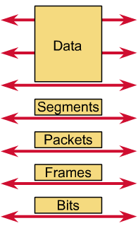
Peer-to-peer communications

Slide 32
Protocols
Is a formal set of rules and conventions that governs how computers exchange information over a network medium.
Implements the functions of one or more of the OSI layers.
A communication protocol is concerned with exchanging data between two peer layers.
Protocol Data Units (PDUs) : Block of data that a protocol exchange.

Slide 33

TCP/IP MODEL

Slide 34
TCP/IP model development
The late-60s The Defense Advance Research Projects Agency (DARPA) originally developed Transmission Control Protocol/Internet Protocol (TCP/IP) to interconnect various defense department computer networks.
The Internet, an International Wide Area Network, uses TCP/IP to connect networks across the world.

Slide 35
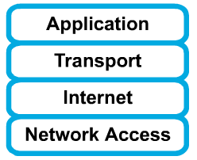
4 layers of the TCP/IP model
Layer 4: Application
Layer 3: Transport
Layer 2: Internet
Layer 1: Network access
It is important to note that some of the layers in the TCP/IP model have the same name as layers in the OSI model.
Do not confuse the layers of the two models.

Slide 36
The network access layer
Concerned with all of the issues that an IP packet requires to actually make the physical link. All the details in the OSI physical and data link layers.
  Electrical, mechanical, procedural and functional specifications.
  Data rate, Distances, Physical connector.
  Frames, physical addressing.
  Synchronization, flow control, error control.

Slide 37
The internet layer
Send source packets from any network on the internetwork and have them arrive at the destination independent of the path and networks they took to get there.
  Packets, Logical addressing.
  Internet Protocol (IP).
  Route , routing table, routing protocol.

Slide 38
The transport layer
The transport layer deals with the quality-of-service issues of reliability, flow control, and error correction.
  Segments, data stream, datagram.
  Connection oriented and connectionless.
  Transmission control protocol (TCP).
  User datagram protocol (UDP).
  End-to-end flow control.
  Error detection and recovery.

Slide 39
The application layer
Handles high-level protocols, issues of representation, encoding, and dialog control.
The TCP/IP combines all application-related issues into one layer, and assures this data is properly packaged for the next layer.
  FTP, HTTP, SMNP, DNS ...
  Format of data, data structure, encode …
  Dialog control, session management …

Slide 40
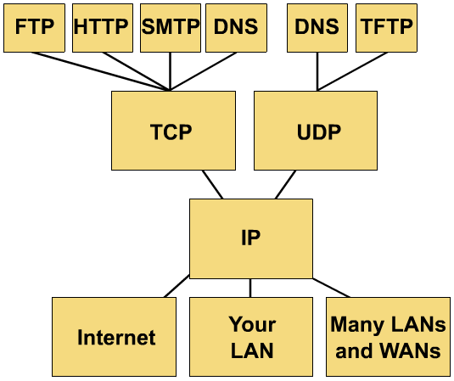
TCP/IP protocol stack

Slide 41
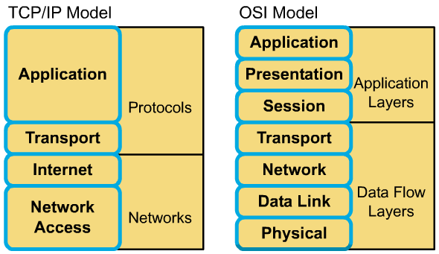
Comparing TCP/IP with OSI

Slide 42
Comparing TCP/IP with OSI (cont.)
Similarities:
  Both have layers.
  Both have application layers, though they include very different services.
  Both have comparable transport and network layers
  Packet-switched technology is assumed.
  Networking professionals need to know both.

Slide 43
Comparing TCP/IP with OSI (cont.)
Differences:
  TCP/IP combines the presentation and session layer issues into its application layer.
  TCP/IP combines the OSI data link and physical layers into one layer.
  TCP/IP appears simpler because it has fewer layers.
  Typically networks aren't built on the OSI protocol, even though the OSI model is used as a guide.

Slide 44
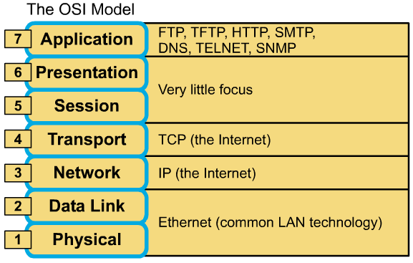
Focus of the OSI Model

Slide 45
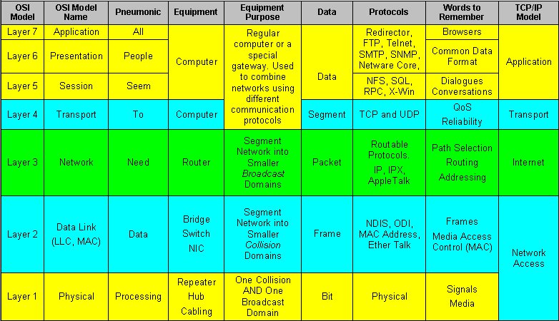
Summary

Slide 46
Thank you!

